Slide 1
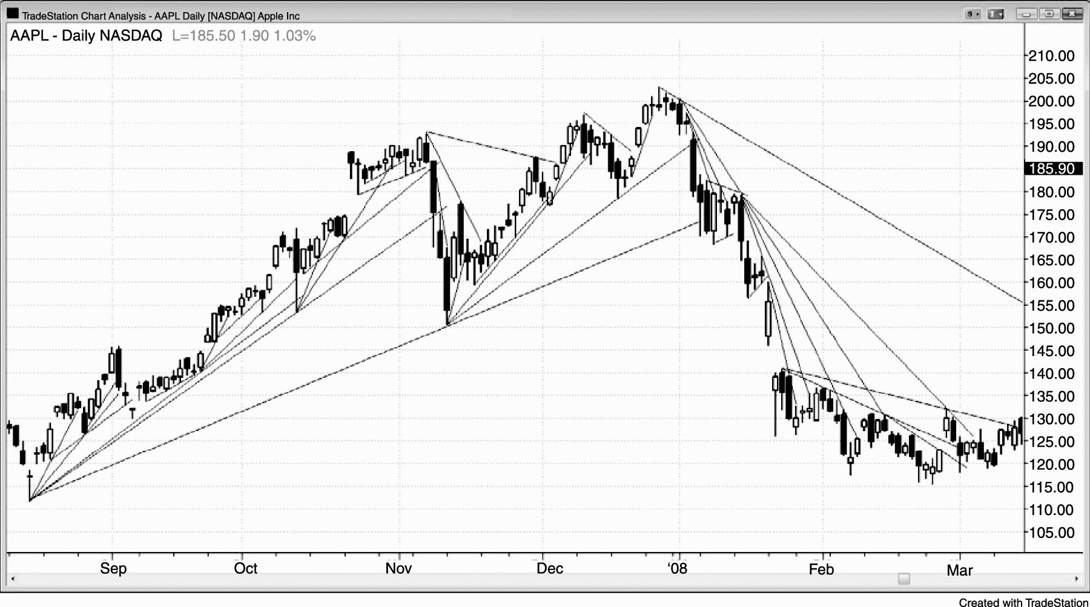
FIGURE 13.1 All Trend Lines Are Important

Slide 2
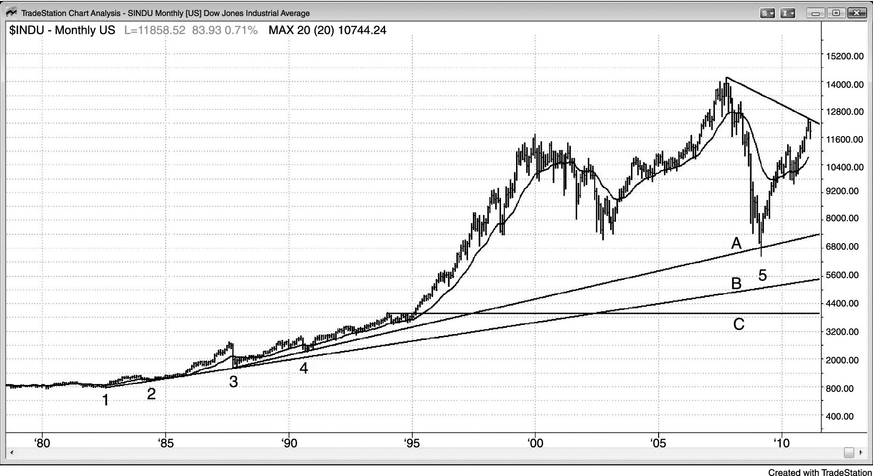
FIGURE 13.2 Monthly Trend Lines

Slide 3
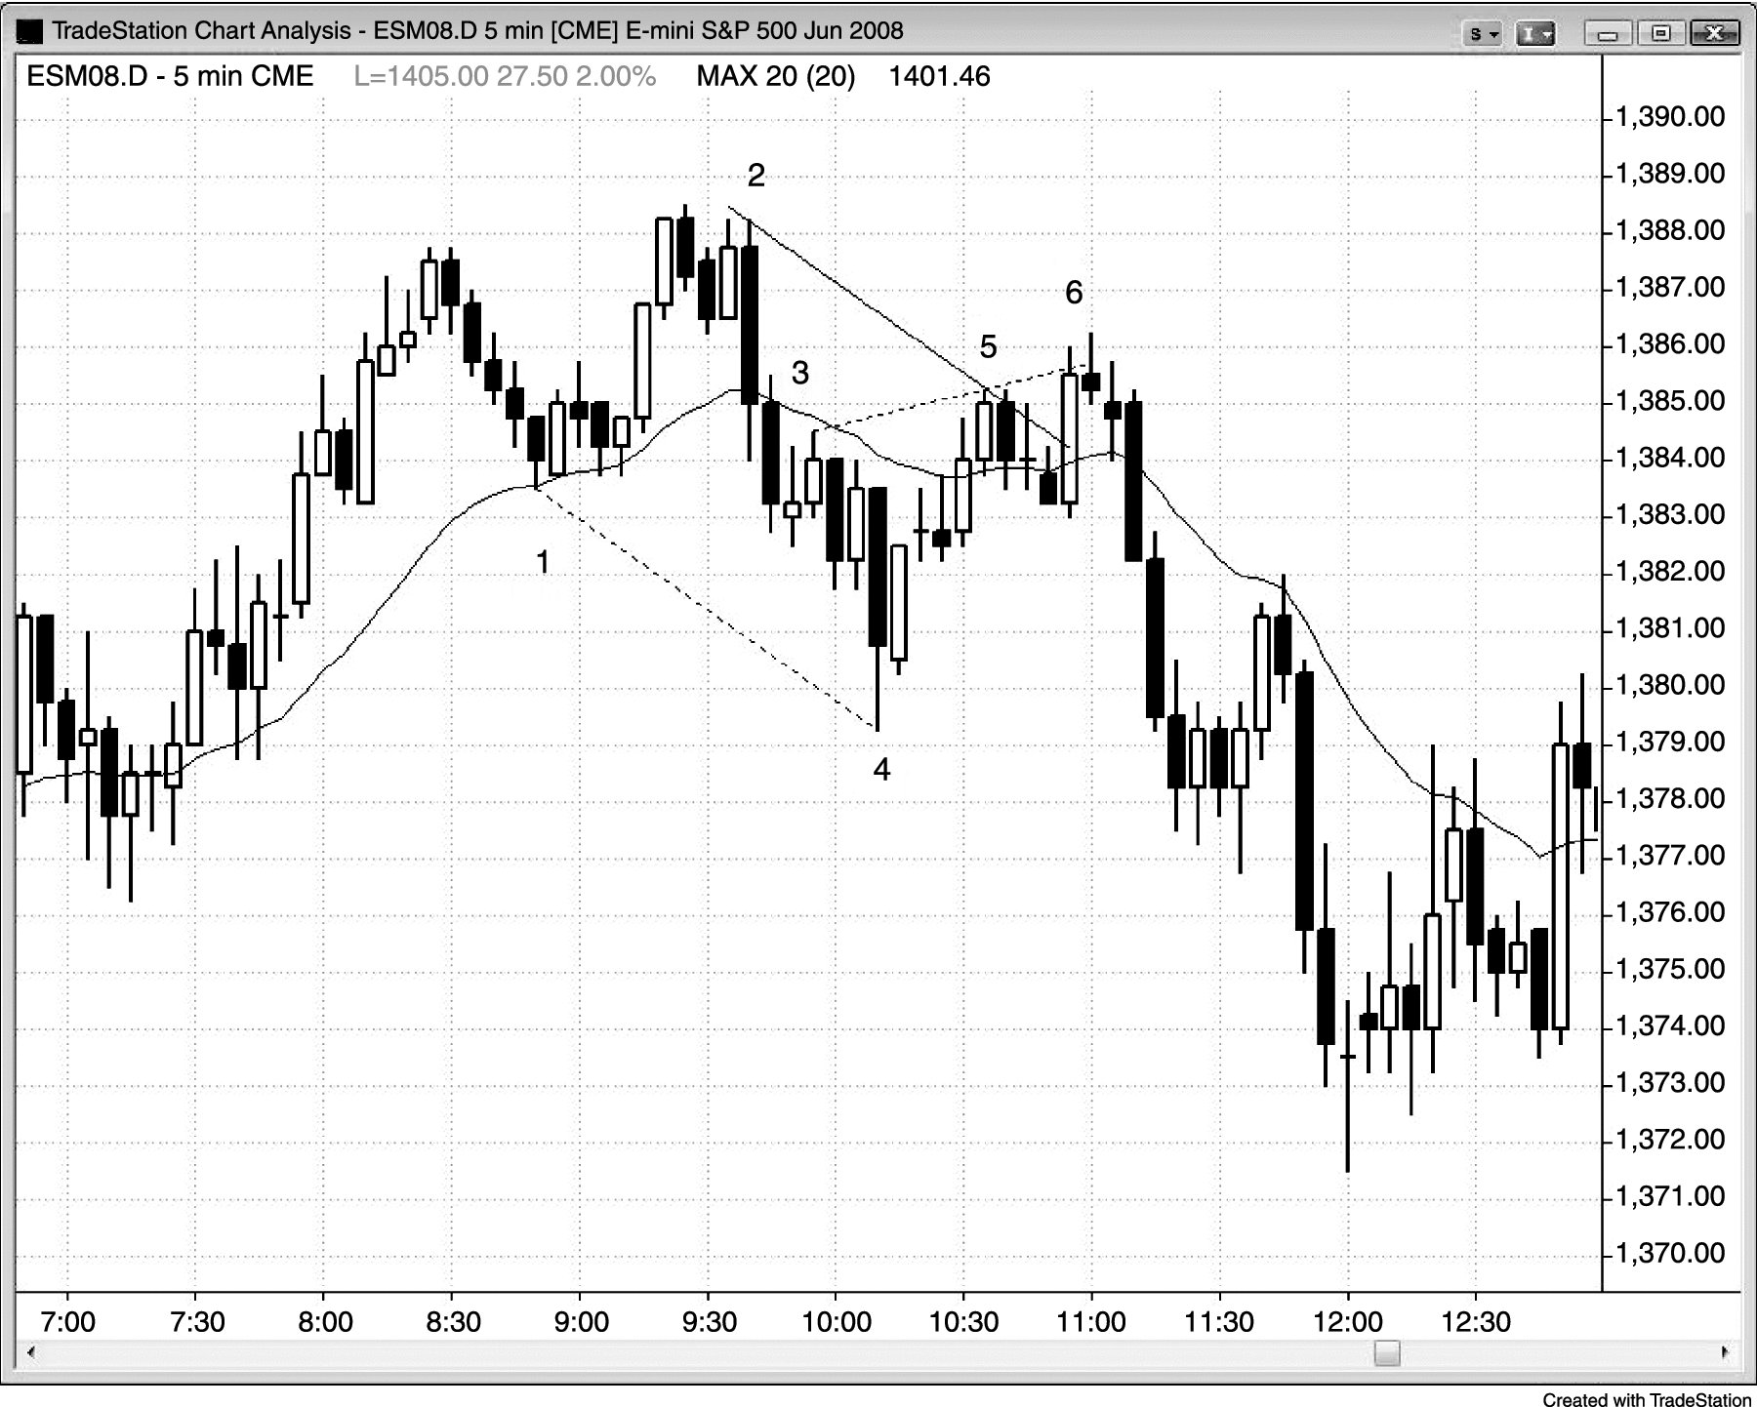
FIGURE 13.3 Trend Line Created as Parallel

Slide 4
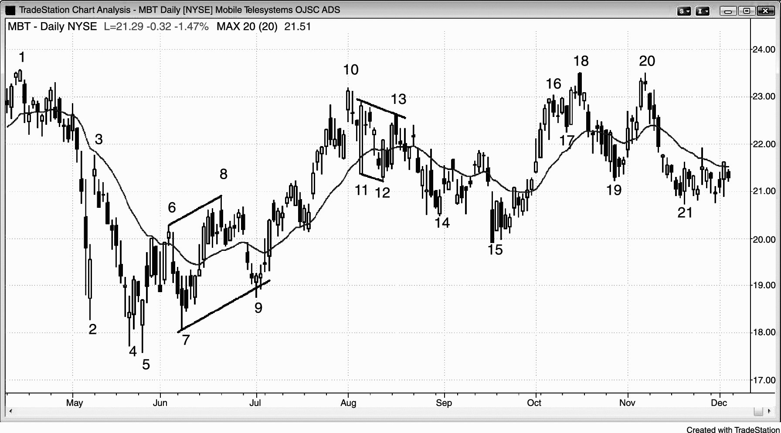
FIGURE 13.4 Trend Channel Line Creating a Channel

Slide 5
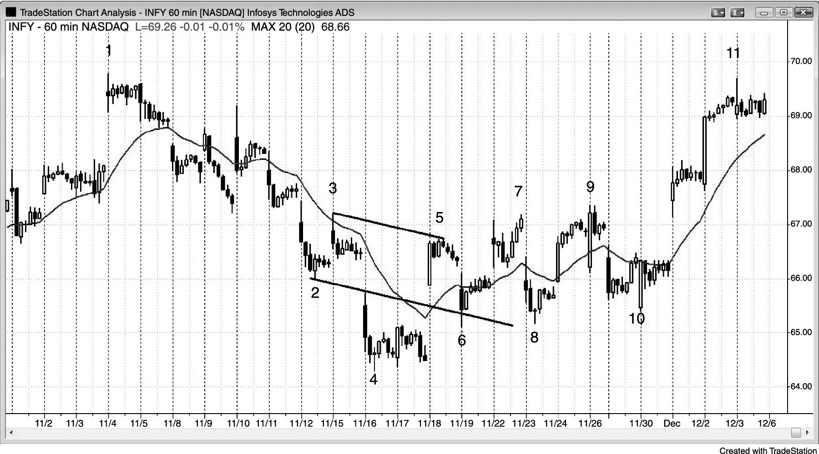
FIGURE 13.5 Head and Shoulders Using Trend Channel Line

Slide 6
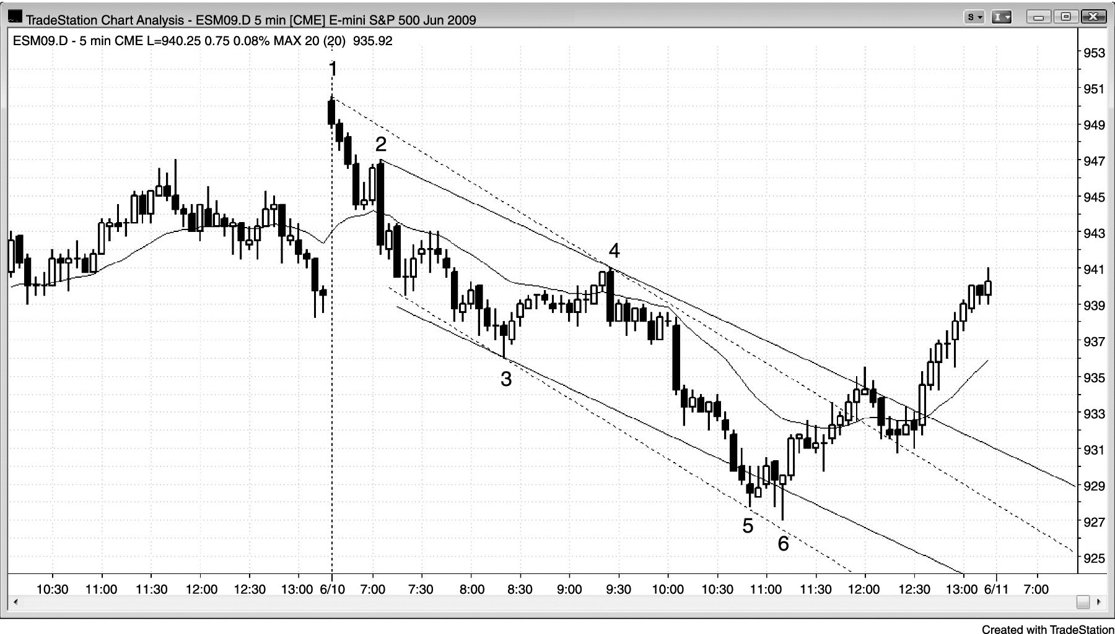
FIGURE 13.6 Trend Channel Line Creating a Channel

Slide 7
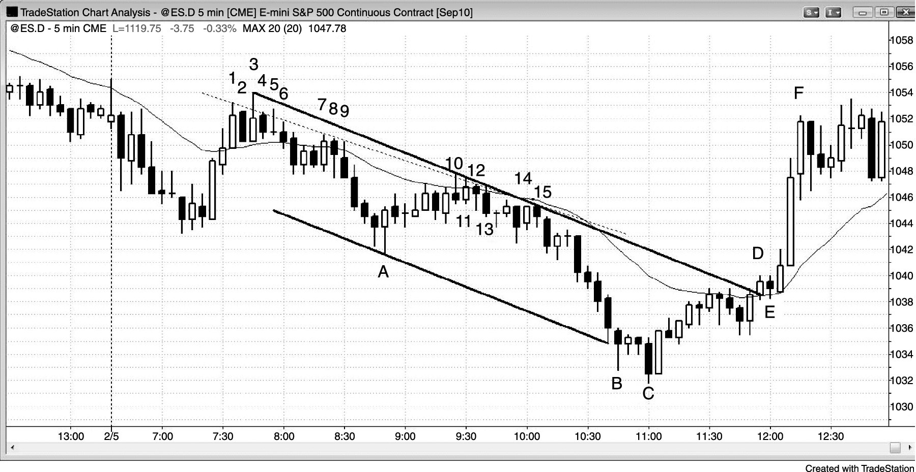
FIGURE 13.7 Repeated Tests of a Trend Line

